Slide 1
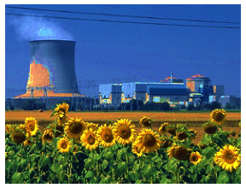
The DECC Global Calculator
A software tool to explore the technical and economic feasibility of 'solutions' to global warming.
Christopher Watson
and Jef Ongena
Energy Group Meeting
European Physical Society
Congresso Società Italiana di Fisica
Roma, Italy
23 September 2015

Slide 2
Introduction
The Global Calculator is a public domain software package designed by a team led by the UK Department of Energy and Climate Change (DECC), aimed at exploring global energy options
It has a ‘front end’ in the form of a user-friendly ‘webtool’, with 48 ‘levers’, permitting the user to design his own preferred option. The webtool includes 26 ‘Example pathways’ which the user can inspect or modify to create his own pathway.
Behind the webtool is a huge Excel spreadsheet, also allowing direct user access, which can give more detailed information
Extensive documentation of the package has been written, but this needs further improvements, especially on the code’s internal workings
The software (& hopefully the documentation) is still being developed
Notes:
COM(2011) 112 A Roadmap for moving to a competitive, low-carbon economy in 2050: 2050 targets for total GHG reduction 79%-82% Power sector only 93%-99%
European Climate Foundation http://www.roadmap2050.eu/attachments/files/Roadmap2050-AllData-MinimalSize.pdf no independent targets defined
A policy framework for climate and energy in the period from 2020 to 2030 /* COM/2014/015 final */ Commission proposes overall GHG target of 40% by 2030 (to be shared between power and other sectors): later versions of same report raise this to 50%

Slide 3
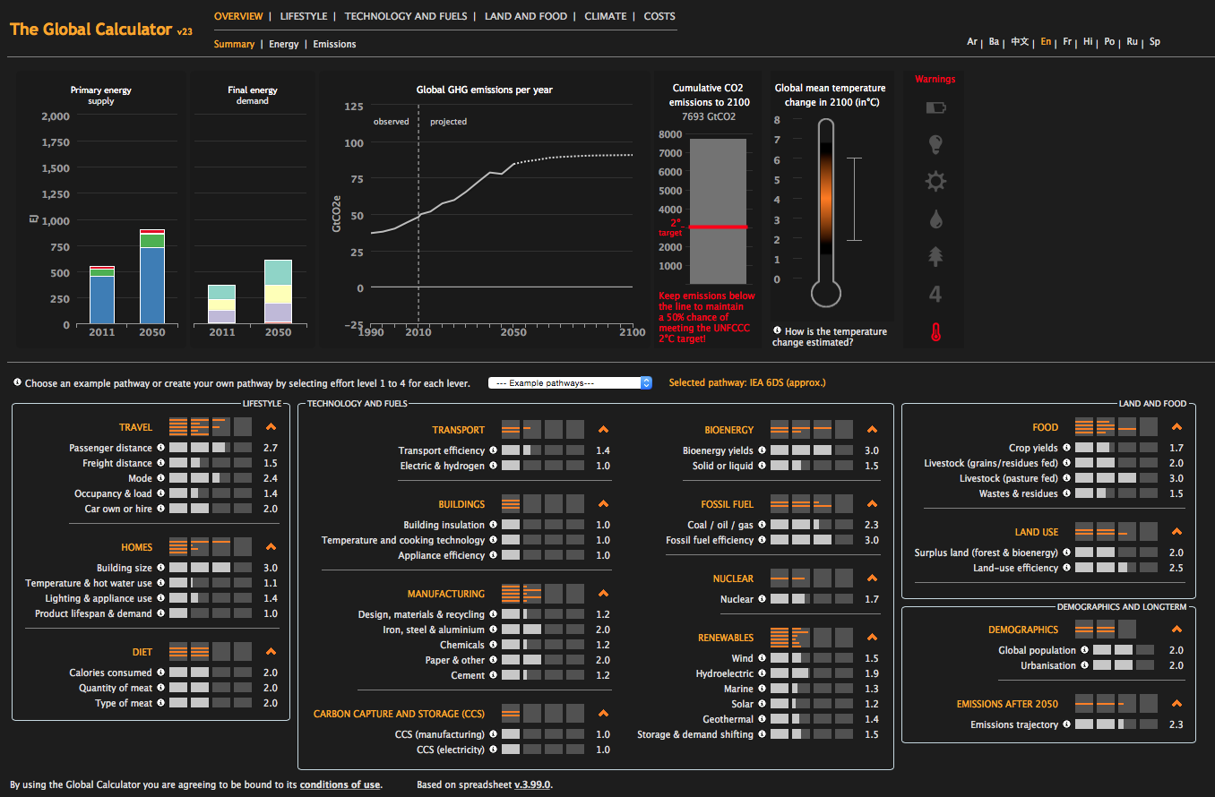
Webtool interface
Warnings
Outputs
‘Levers’
Notes:
COM(2011) 112 A Roadmap for moving to a competitive, low-carbon economy in 2050: 2050 targets for total GHG reduction 79%-82% Power sector only 93%-99%
European Climate Foundation http://www.roadmap2050.eu/attachments/files/Roadmap2050-AllData-MinimalSize.pdf no independent targets defined
A policy framework for climate and energy in the period from 2020 to 2030 /* COM/2014/015 final */ Commission proposes overall GHG target of 40% by 2030 (to be shared between power and other sectors): later versions of same report raise this to 50%

Slide 4
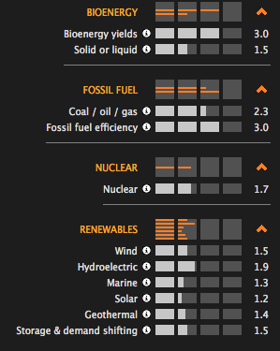
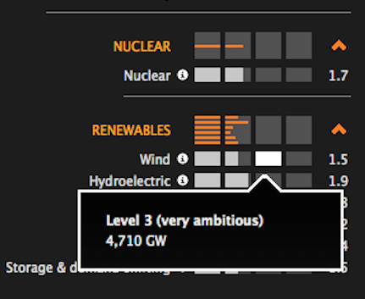
Detailed view of some of the ‘levers’
Values from 1 to 4 with online short explanation

Slide 5
List of the first twelve of the 48 levers of the model,
together with their current values
Sector
Lever
Current situation (in 2010 or 2011)
In 2010 the world
population was around 6.9
1
Population
Global population
billion.
In 2010, 52% of the world
’
s population lived in
2
Urbanisation
urban areas.
In 2011, the weighted average distance travelled
3
Passenger distance
per pe
rson was around 7,500 km / year
In 2011
freight shipped
was 65 trillion tonne
-
4
Freight distance
km
In 2011,
the global average
distance travelled
by
Transport
car
was around 40%.
Roughly 83% of freight
5
Mode
tonne
-
km is made by truck or ship
Light
-
duty vehicles 10 litres/100km, heavy 32
6
Efficiency
litres. Improving at ~ 1
-
2% pa
In 2011 ~5% of global fleet used hybrid
7
Electric and hydrogen
technology, very little used 100% electric
2
Average urban house floor area 92 m
per
8
Building size
2
household: service buildings 5 m
per capita
0
0
18
C for urban and 13
C for rural residential,
0
20
C for non
-
residential in winter. The summer
0
figures are 27, 29 and 23
C. Hot water demand
9
Temperature & hot water use
is 18263 litres/y/capita
Average household
h
as 1 fridge, 0.8 clothes
-
Buildings
washers, 0.3 dishwashers, 0.3 clothes dryers, 1.6
10
Lighting, cooking & appliance use
TVs and 20 lightbulbs
Average heat loss coefficient of buildings is 15
11
Building insulation
0
GW/Mha
C
Heating technology is 2% solid boiler, 14% liquid
boiler, 55% gas boiler, 2% heat pumps, 8%
electric heater, 0% solar, 2% micro CHP, 17%
12
Temperature,
cooking & lighting technology
district heating. Lighting: 72% incandescent, 3%

Slide 6
Webtool Outputs
Five output pages with summarizing diagrams
(each with further subpages):
Overview: overall summary of energy flows & emissions outputs
Lifestyle: graphs showing trends in home, travel & diet figures
Technology and Fuels: graphs of trends in car & freight transport
Land and Food: trends in land use, food production & forestry
Climate: information on cumulative CO2 emissions & temperature rise
Costs: total energy system cost up to 2050 (capital, operating & fuel)
Two auxiliary pages providing further user support:
Compare: compares user’s pathway with other ‘example pathways’
Share: enables user to share his set of levers with other users

Slide 7
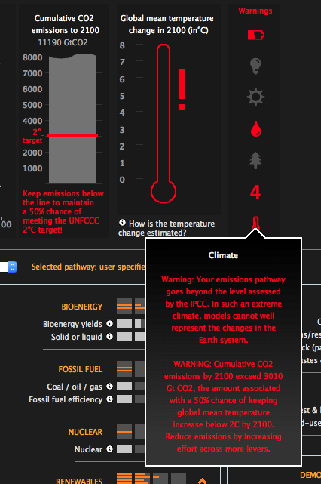
Detailed view of some Webtool outputs and warnings
Energy Security
Electricity
Technological problems
Problems with resources
Problems with land use
Extreme values
Climate problems
Very dangerous pathway
Too much CO₂, high temp.
Online explanation of the
warning

Slide 8
Webtool outputs from three ‘representative’ pathways
Energy figures from Sankey diagrams | High nuclear (WNA Allegro) |  | High renewable (Climact) |  | Intermediate (ICEPT)
Energy Inputs (EJ) | 652 |  | 458 |  | 646
Renewables | 206 | 32% | 176 | 38% | 218 | 34%
Nuclear | 131 | 20% | 26 | 6% | 49 | 8%
Fossil | 240 | 37% | 187 | 41% | 274 | 42%
Biomass | 75 | 11% | 69 | 15% | 105 | 16%
End-use Outputs (EJ) | 640 |  | 441 |  | 631
Buildings | 136 | 21% | 90 | 20% | 135 | 21%
Manufacturing | 170 | 27% | 114 | 26% | 211 | 34%
Transport | 97 | 15% | 83 | 19% | 88 | 14%
Agriculture | 8 | 1% | 6 | 1% | 6 | 1%
Losses | 229 | 36% | 148 | 34% | 191 | 30%
Emissions (Gt)
Gt CO_{2e} in 2050 | 22.5 |  | 17.7 |  | 19
Cumulative to 2100 | 3003 |  | 2882 |  | 2768
Temperature rise (⁰ C) | 2.45 |  | 2.15 |  | 2.1

Slide 9
Excel spreadsheet version
Contains a lot more information than the webtool reveals. It has sixty separate sheets, each labelled with a tab, and all communicating with each other. Finding relevant information within them can be difficult.
Aimed at the experienced Excel user (preferably those familiar with advanced Excel coding techniques), but can be used as a ‘black box’.
Unfortunately, the currently available documentation is very inadequate, particularly as regards the assumptions & the methods used to calculate the consequences of the user’s lever choices.
We would also wish for a better interface between webtool and spreadsheet, to facilitate using the webtool to help the user to define a pathway & to understand how individual lever choices interact.

Slide 10
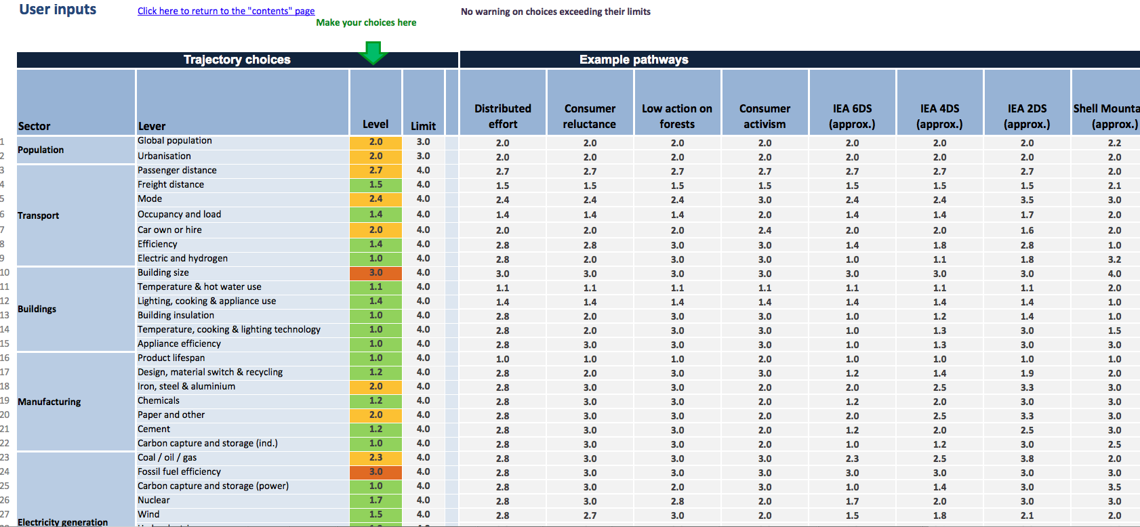
Excel spreadsheet
User input tab
Various ‘Example pathways’

Slide 11
Practical experience
Using the webtool together with the spreadsheet has been very educational, but at times frustrating
We have selected three pathways from the set of 26 ‘example pathways’ as being representative of three global strategies:
‘High nuclear’ – ie with over 1800 GWe of installed capacity
‘High Renewables’ – ie with ~ 7500 GW of wind, solar & hydro capacity
‘Intermediate’ – with roughly equal contributions of nuclear, renewable & CCS
All three achieve an estimated temperature rise of < 2.5 ⁰C
We have tried but failed to fine-tune these to get down to <2 ⁰ C
The problem has been to avoid ‘unintended consequences’ of levers.
Several ‘curious’ consequences of specific lever settings have been observed. We need to understand these and/or report them to the developers.

Slide 12
Conclusions
We believe that the Calculator is the most complete simulation of the influence of man on climate published so far. It can already be used by those who participate in energy and climate discussions to explore the various dependencies involved.
But it needs better /more “levers” to represent actions required by the intermittency of renewable energy, and better documentation.
Its cost calculations are too preliminary. The user needs absolute numbers (£, €), taking into account the full energy system (e.g. for renewable energy including storage, backup, transmission lines, etc…)
We have already discovered that the Calculator gives some new insights into the climate change problem facing mankind.

